Slide 2
Variance Reduction at Scale
Improving IMC variance reduction methods
for thermal transport problems
Scott Campbell
Gonzaga University
Physics & Math-Computer Science
LA-UR-19-28106

Slide 3
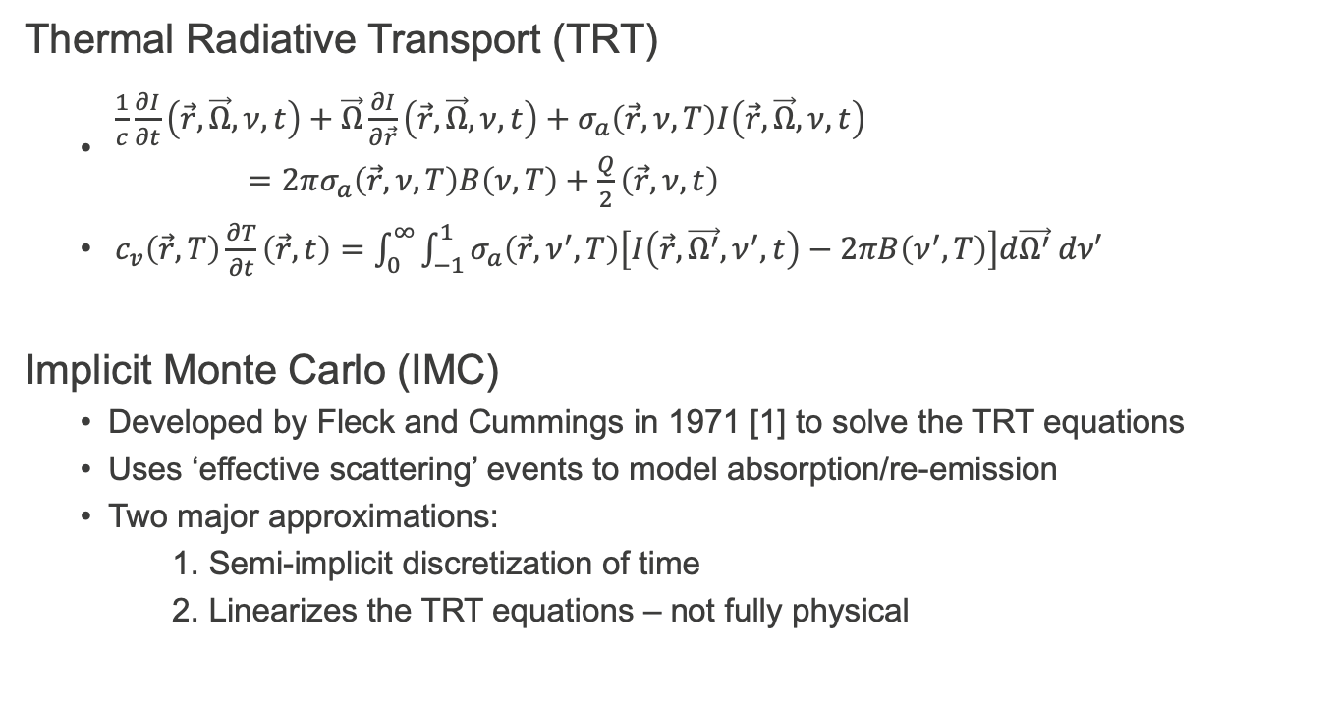
Introduction & Theory
Thermal Radiative Transport (TRT)
$\begin{aligned} \frac{1}{c}\frac{∂I}{∂t}\left(\vec{r},\vec{Ω},ν,t\right)+\vec{Ω}\frac{∂I}{∂\vec{r}}\left(\vec{r},\vec{Ω},ν,t\right)+σ_{a}\left(\vec{r},ν,T\right)I\left(\vec{r},\vec{Ω},ν,t\right) \\ =2πσ_{a}\left(\vec{r},ν, T\right)B\left(ν, T\right)+\frac{Q}{2}\left(\vec{r},ν,t\right) \#\end{aligned}$
$c_{v}\left(\vec{r},T\right)\frac{∂T}{∂t}\left(\vec{r},t\right)=\int_{0}^{∞}{\int_{−1}^{1}{σ_{a}\left(\vec{r},ν^{′},T\right)\left[I\left(\vec{r},\vec{Ω^{′}},ν^{′},t\right)−2πB\left(ν^{′},T\right)\right]d\vec{Ω^{′}} dν′}}$
Implicit Monte Carlo (IMC)
Developed by Fleck and Cummings in 1971 [1] to solve the TRT equations
Uses ‘effective scattering’ events to model absorption/re-emission
Two major approximations:
1. Semi-implicit discretization of time
2. Linearizes the TRT equations – not fully physical

Slide 4
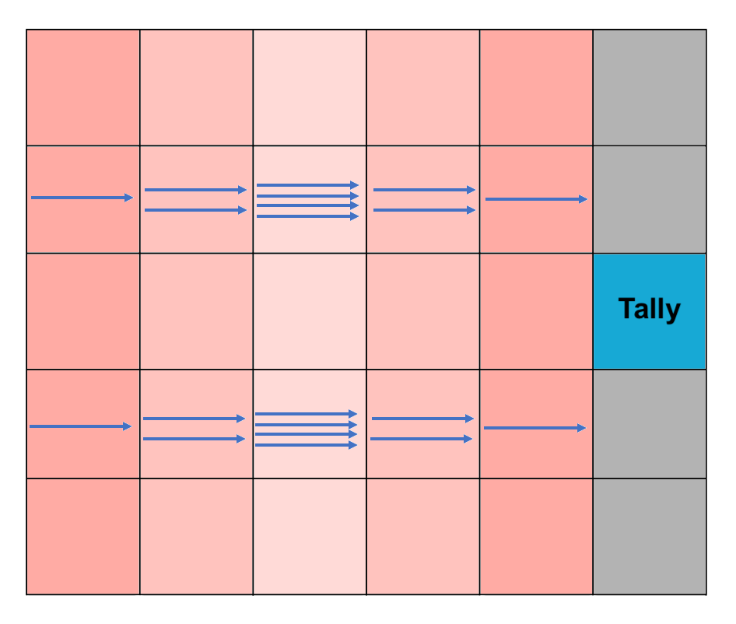
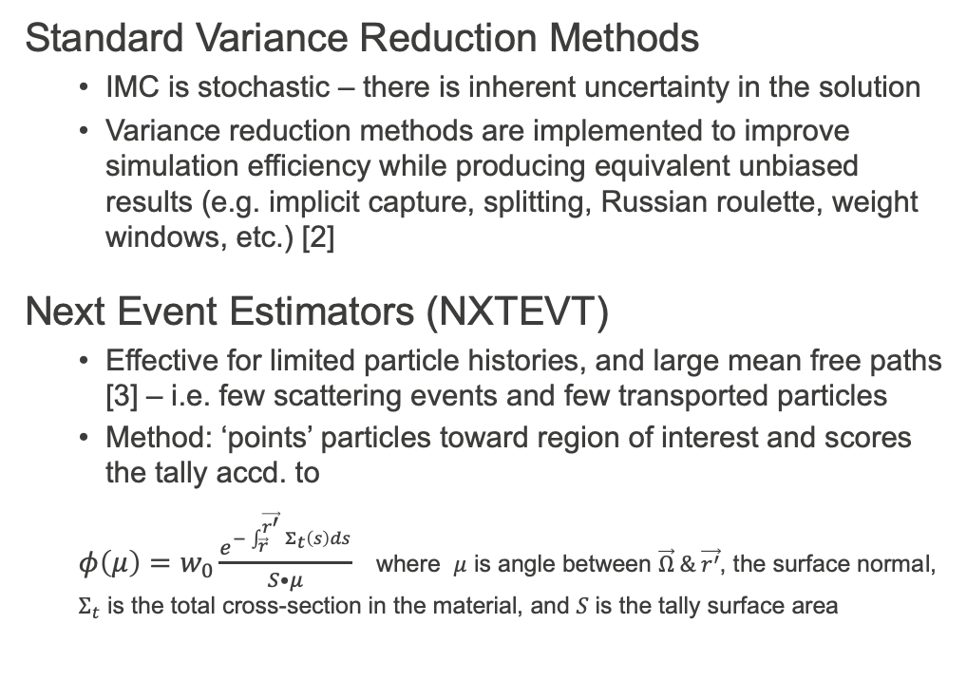
Introduction & Theory Cont.
Standard Variance Reduction Methods
IMC is stochastic – there is inherent uncertainty in the solution
Variance reduction methods are implemented to improve simulation efficiency while producing equivalent unbiased results (e.g. implicit capture, splitting, Russian roulette, weight windows, etc.) [2]
Next Event Estimators (NXTEVT)
Effective for limited particle histories, and large mean free paths [3] – i.e. few scattering events and few transported particles
Method: ‘points’ particles toward region of interest and scores the tally accd. to
$φ\left(μ\right)=w_{0}\frac{e^{−\int_{\vec{r}}^{\vec{r^{′}}}{Σ_{t}\left(s\right)ds}}}{S•μ}$ where $μ$ is angle between $\vec{Ω} \& \vec{r^{′}}$, the surface normal, $Σ_{t}$ is the total cross-section in the material, and $S$ is the tally surface area
Figure 1:
A visualization as to why splitting and Russian roulette are ineffective in cases of interest to NXTEVT. Particles not initially directed towards the tally won’t likely reach it.

Slide 5
Research Objective & Motivation
Motivation
We attempt to produce a light curve with Monte Carlo from a simplified model of a supernova (SN2006gy) interacting with its circumstellar medium [4]
The opacities of the supernova ejecta and ejecta-CSM Shock do not lend itself well to standard VRMs or the NXTEVT estimator
The multi-physics involved require a large number of particles for answer to converge – makes the simulation computationally expensive
Objective
Investigate the advantages of a response function based VRM for problems modeling supernova-CSM interactions
Provide high-quality simulation data to compare with physical observation

Slide 6
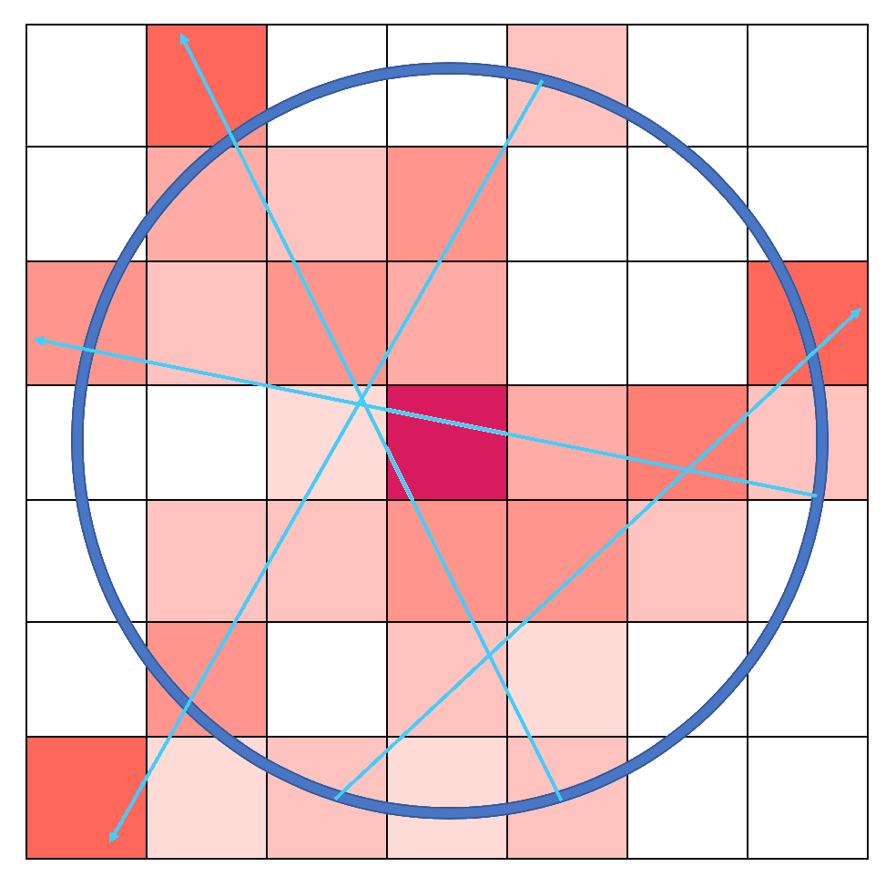
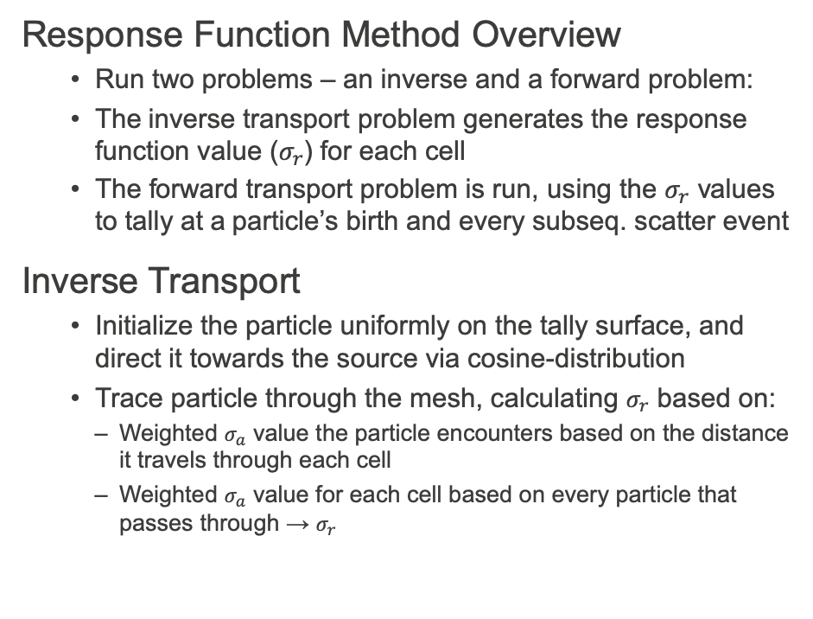
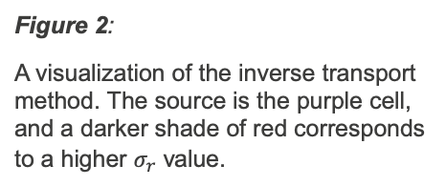
Method and Technical Approach
Response Function Method Overview
Run two problems – an inverse and a forward problem:
The inverse transport problem generates the response function value ($σ_{r}$) for each cell
The forward transport problem is run, using the $σ_{r}$ values to tally at a particle’s birth and every subseq. scatter event
Inverse Transport
Initialize the particle uniformly on the tally surface, and direct it towards the source via cosine-distribution
Trace particle through the mesh, calculating $σ_{r}$ based on:
Weighted $σ_{a}$ value the particle encounters based on the distance it travels through each cell
Weighted $σ_{a}$ value for each cell based on every particle that passes through → $σ_{r}$
Figure 2:
A visualization of the inverse transport method. The source is the purple cell, and a darker shade of red corresponds to a higher $σ_{r}$ value.

Slide 7
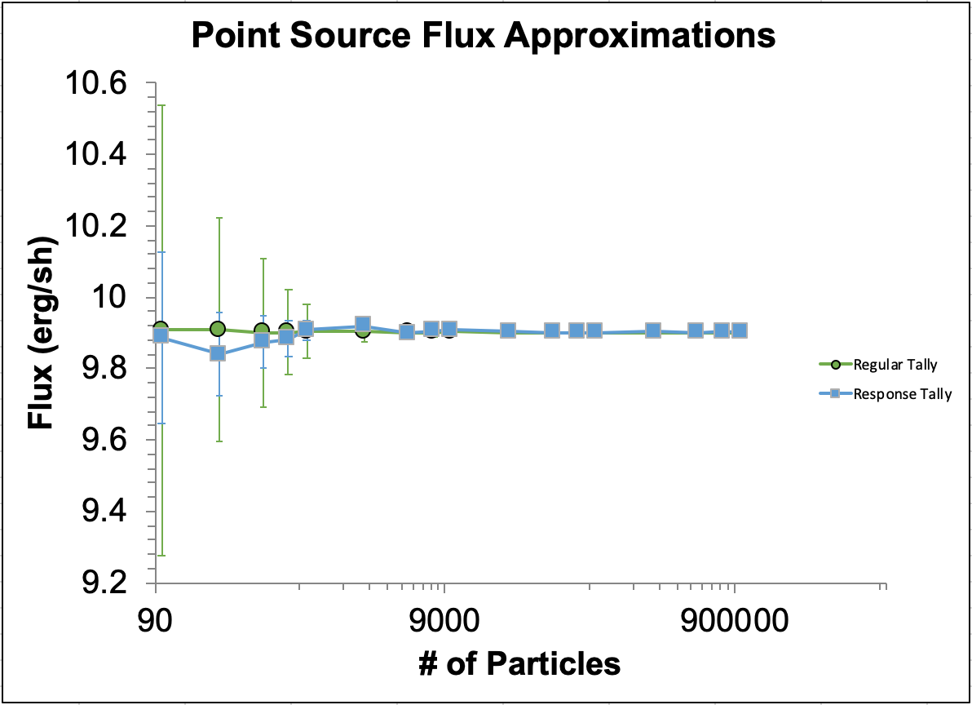
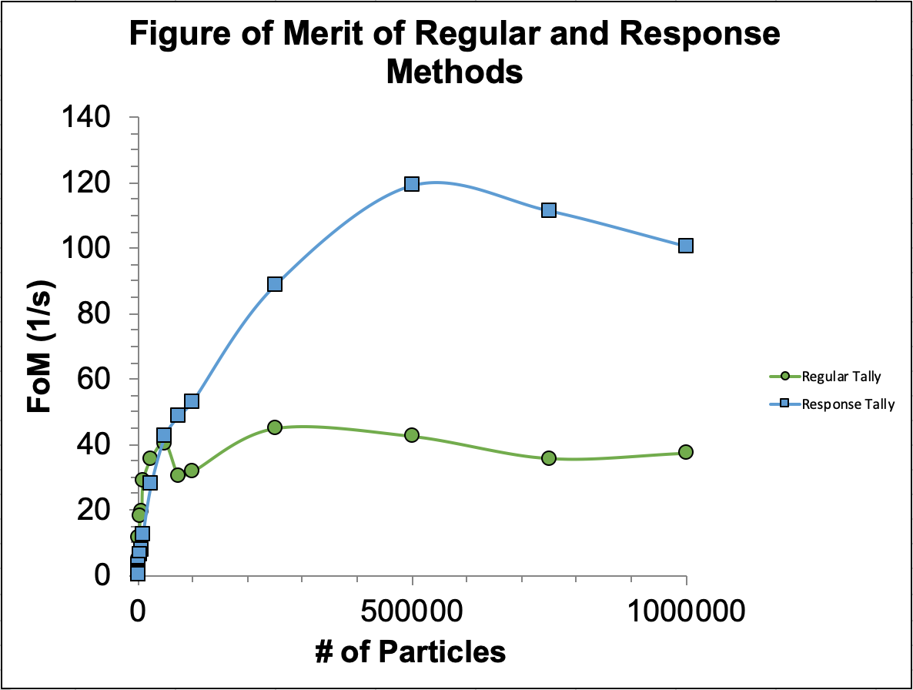
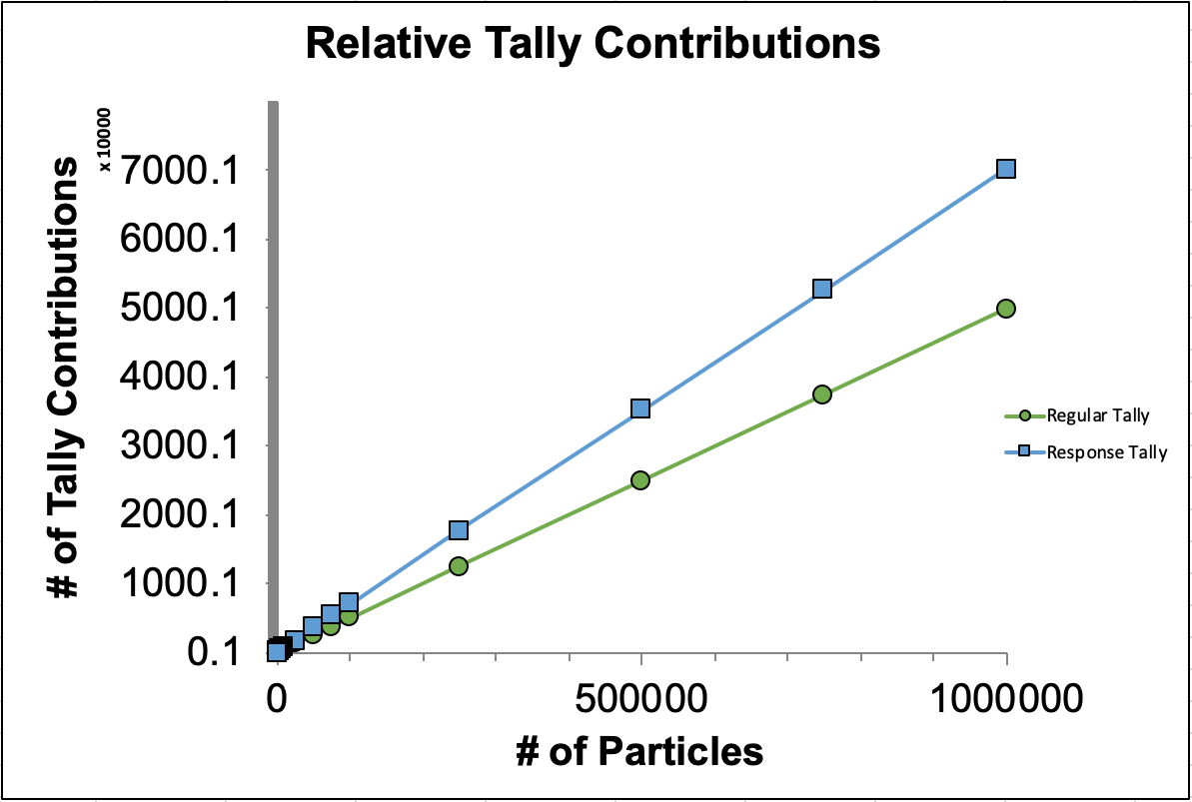
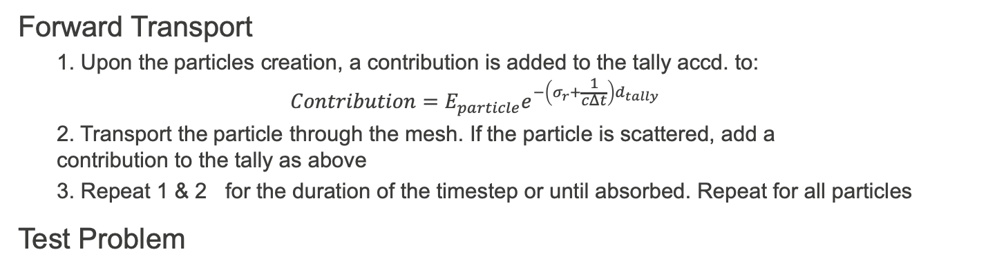
Method Cont. & Testing
Forward Transport
1. Upon the particles creation, a contribution is added to the tally accd. to:
$$Contribution=E_{particle}e^{−\left(σ_{r}+\frac{1}{cΔt}\right)d_{tally} }$$
2. Transport the particle through the mesh. If the particle is scattered, add a contribution to the tally as above
3. Repeat 1 & 2 for the duration of the timestep or until absorbed. Repeat for all particles
Test Problem

Slide 8
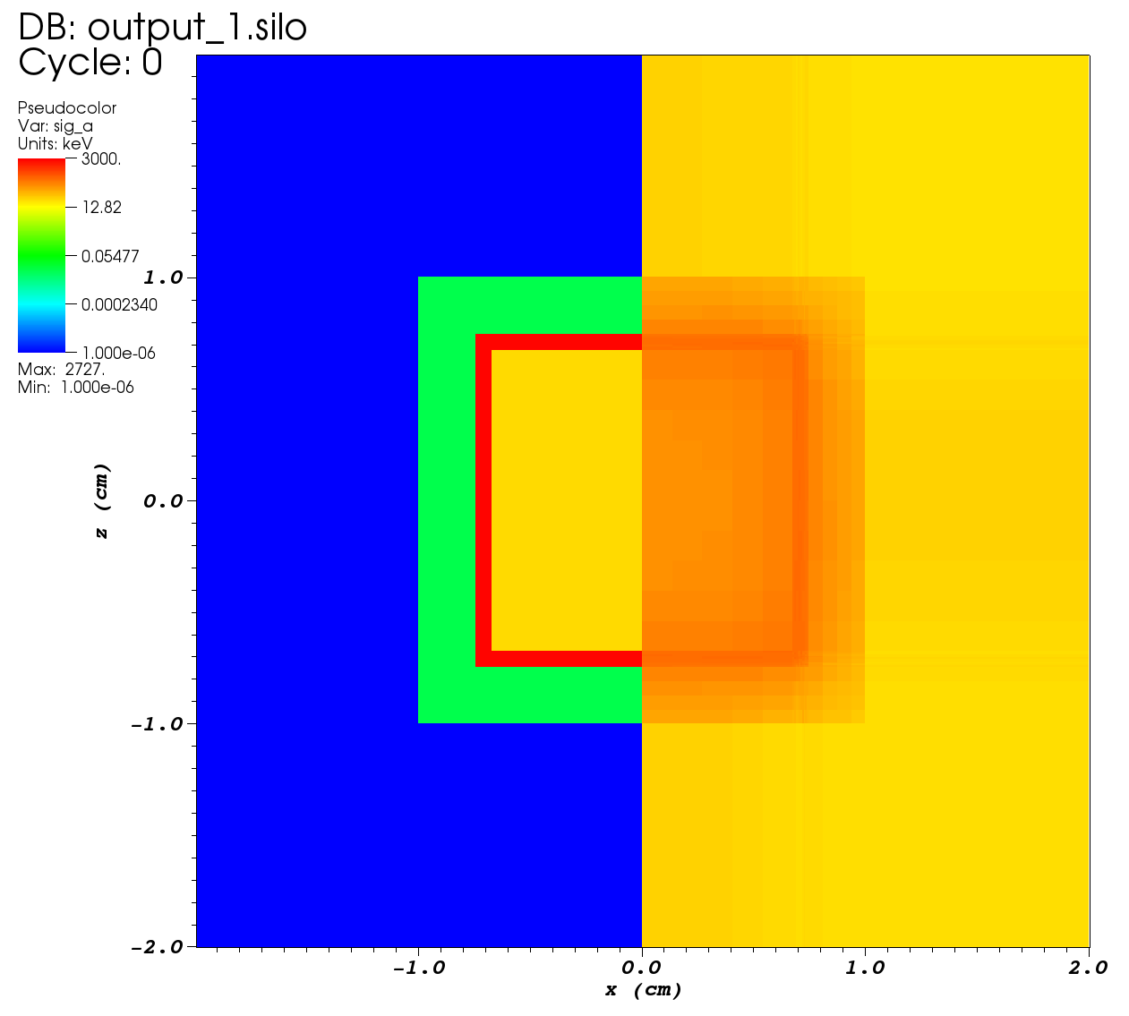
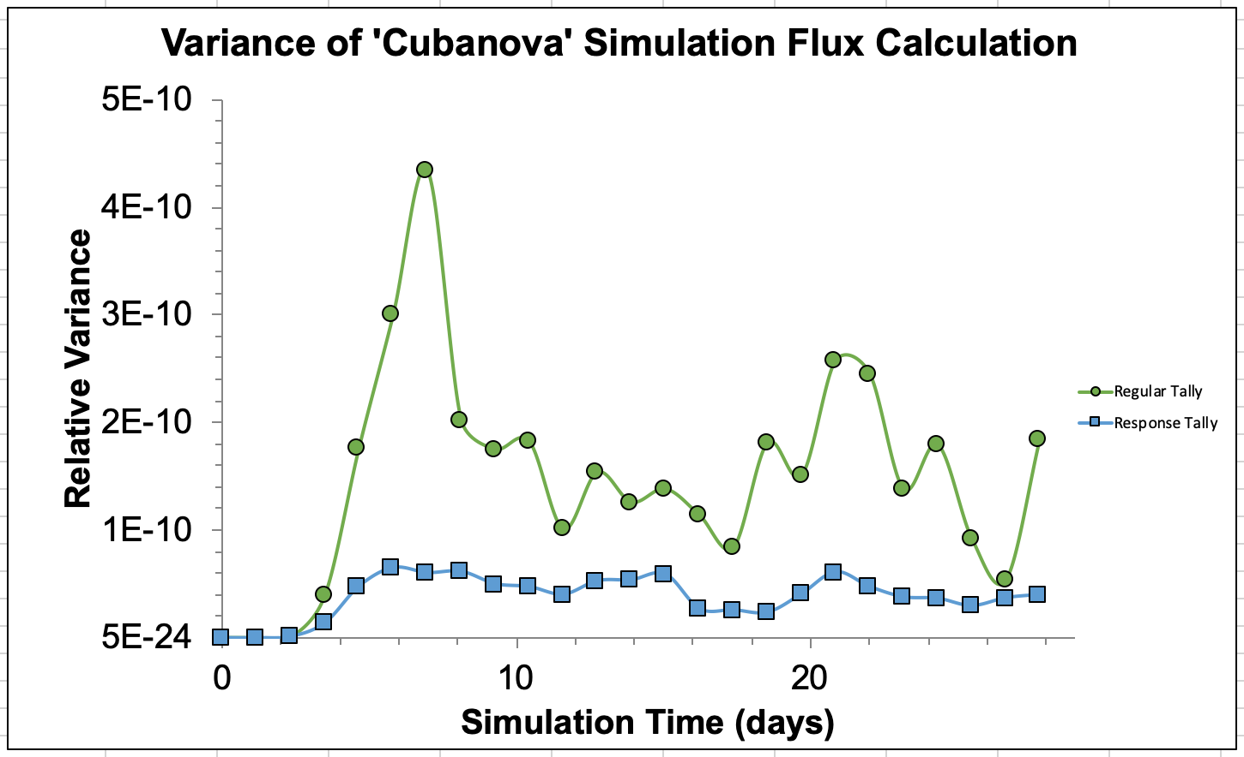
Supernova Applications

Slide 9
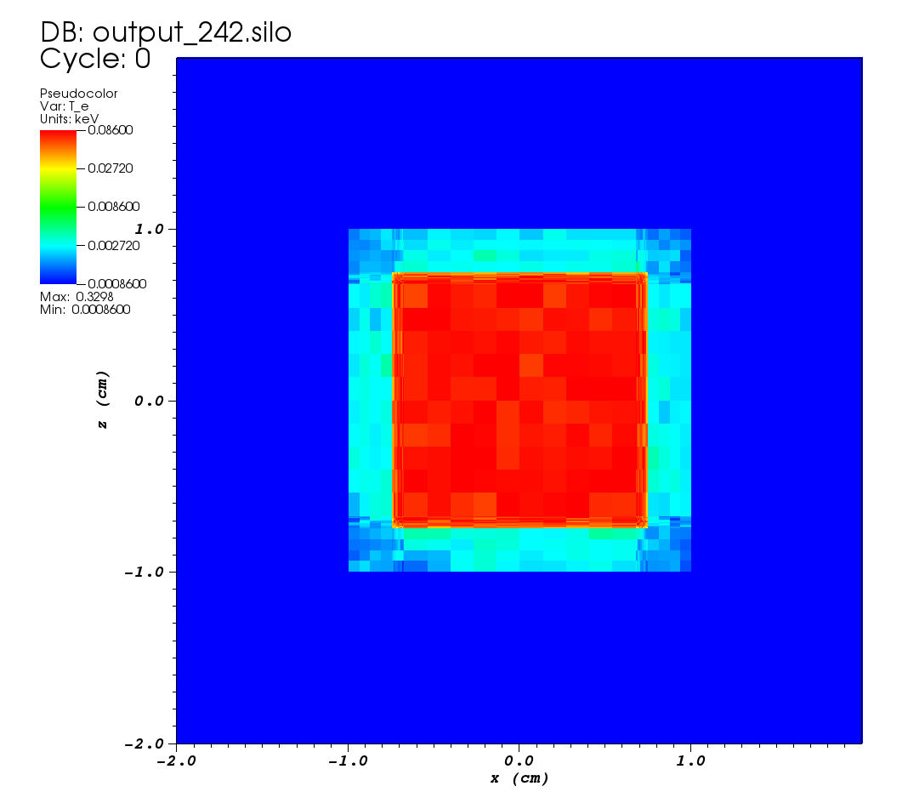
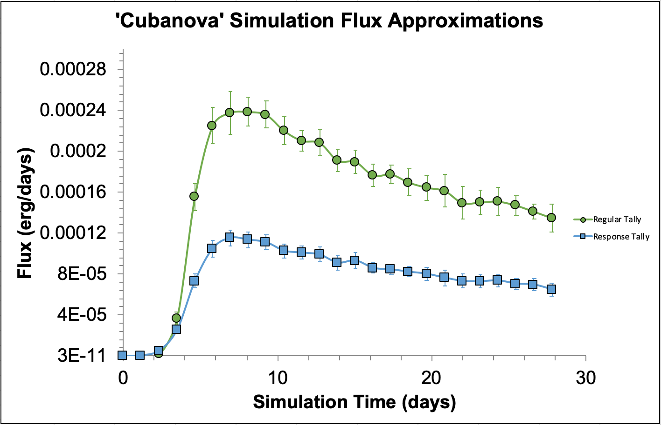
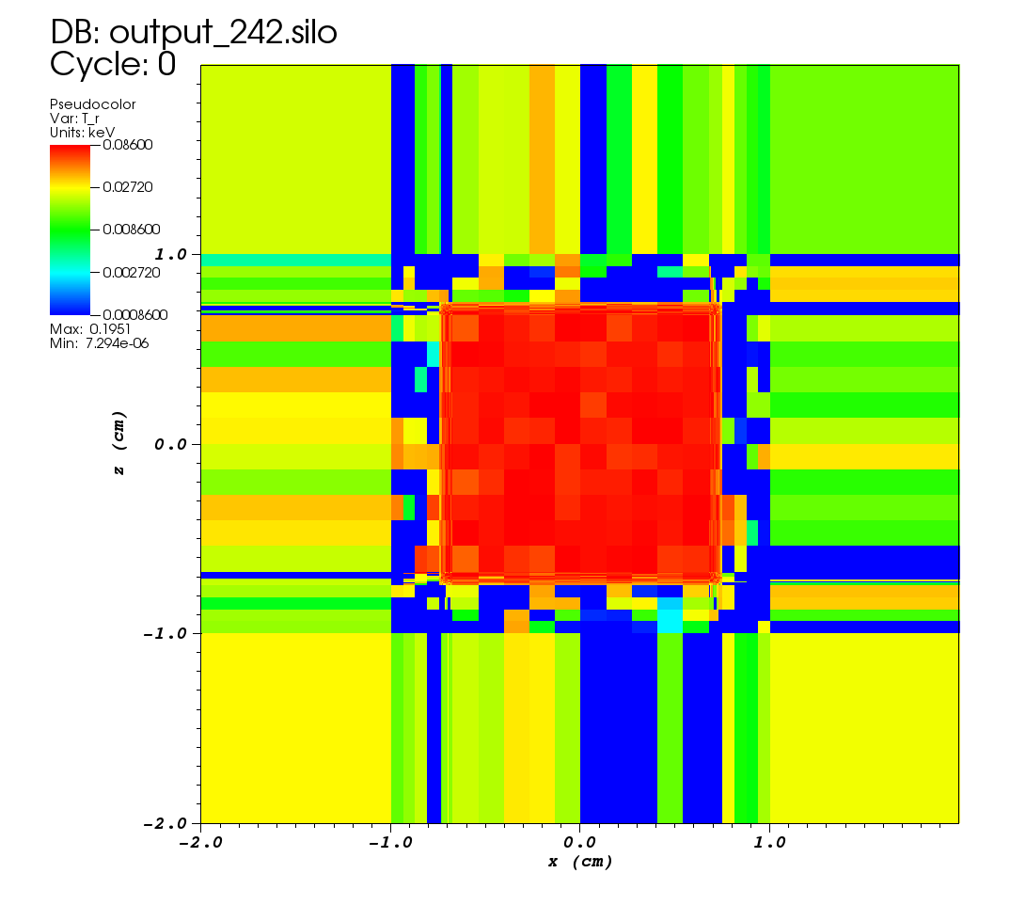
Supernova Applications Cont.

Slide 10
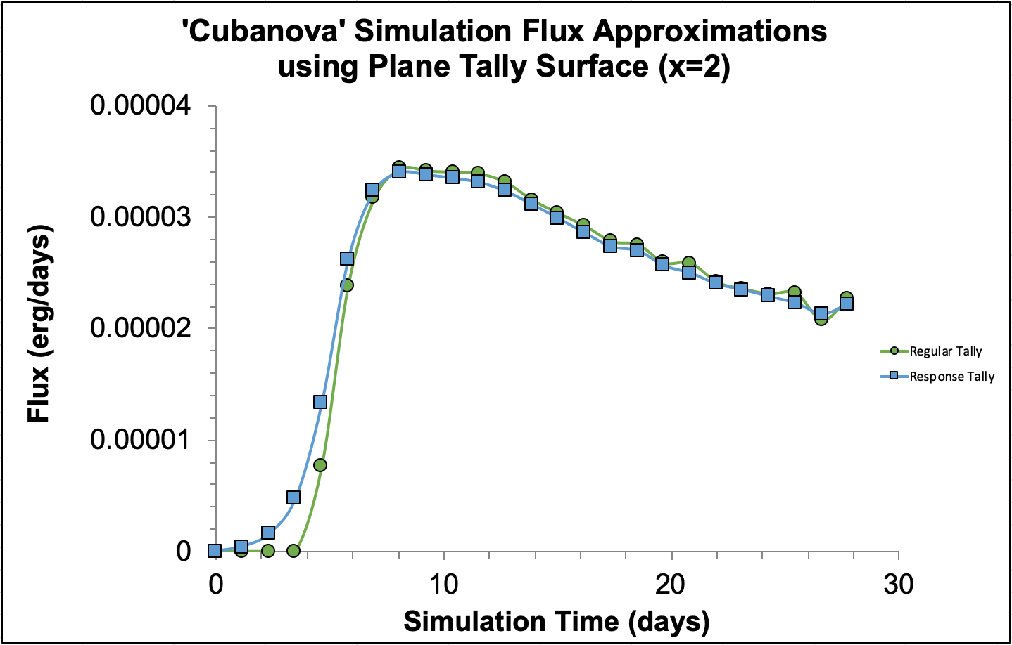
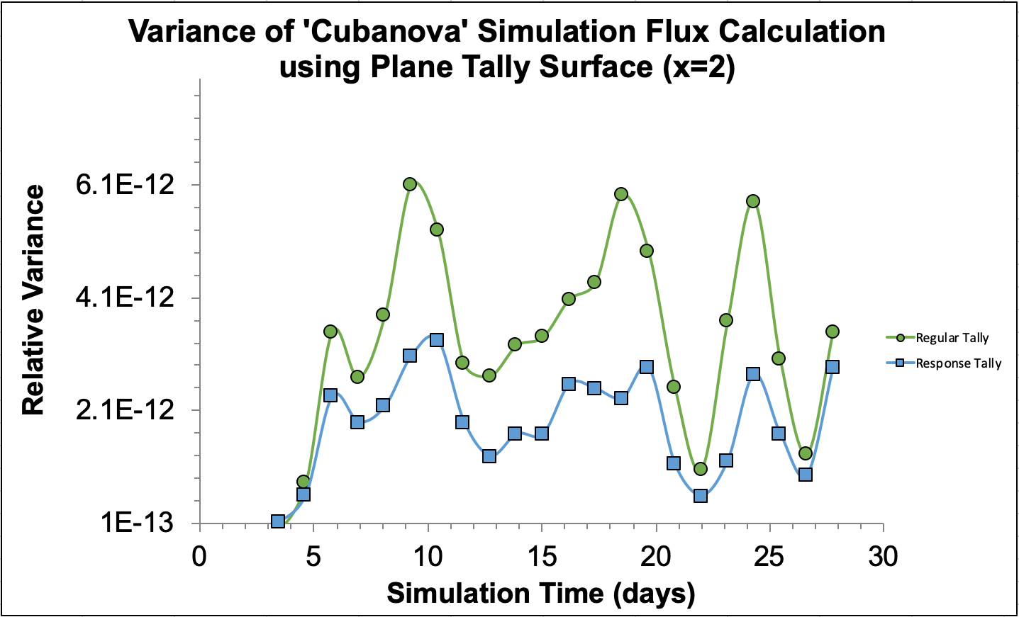
Supernova Applications Cont.

Slide 11
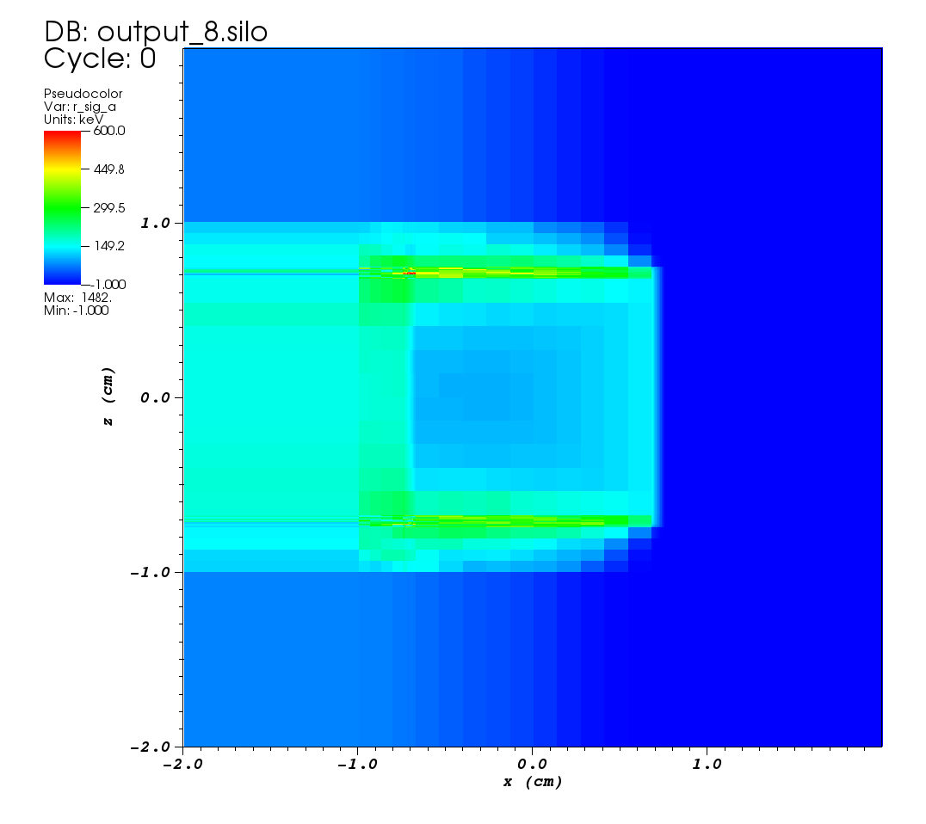
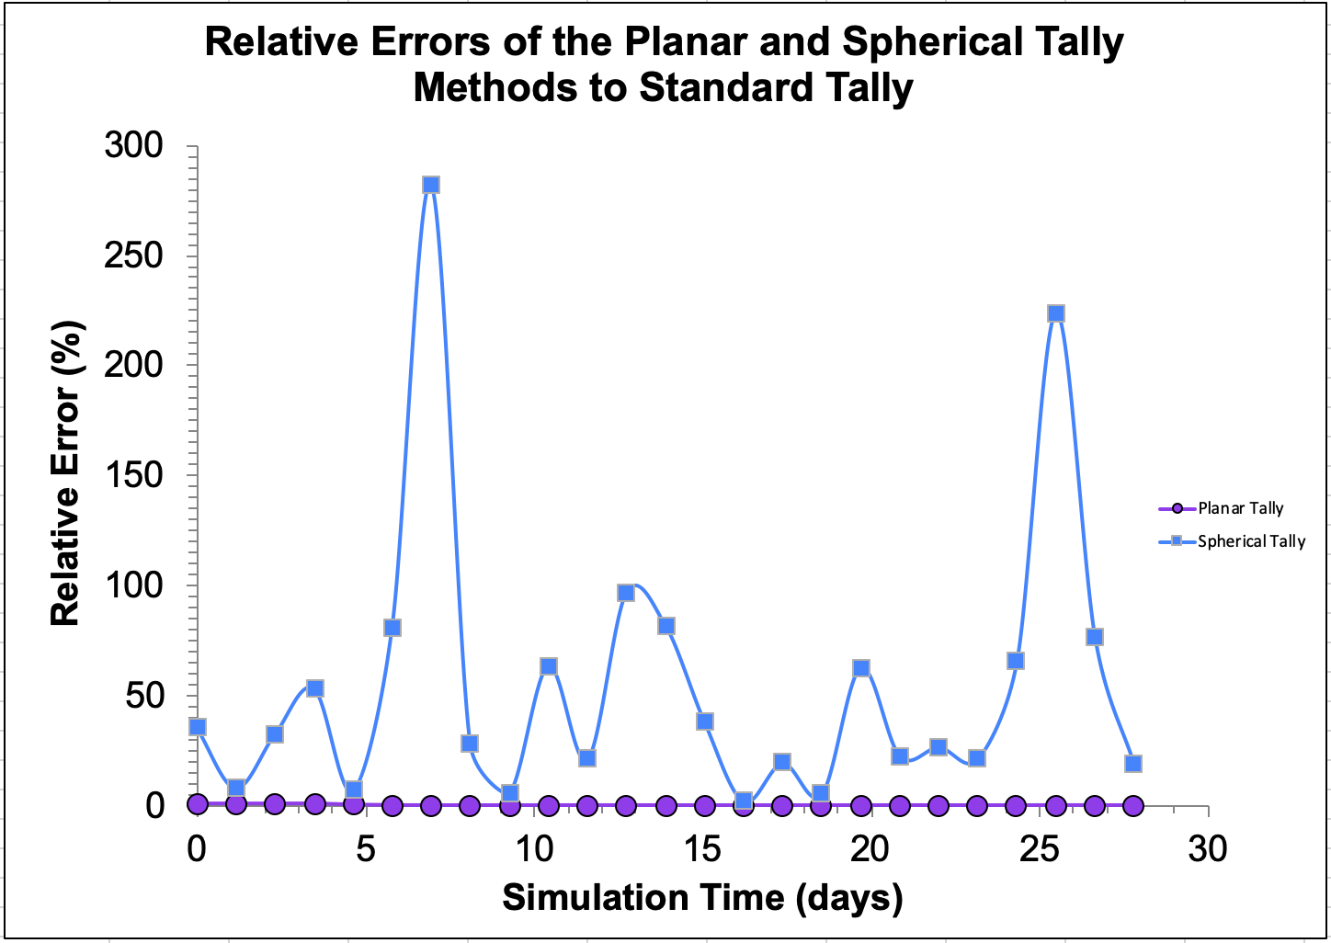
Supernova Applications Cont.

Slide 12
Conclusions & Future Work
Our investigation into the use of a response function-based variance reduction method has shown a notable improvement in variance over standard methods.
Our method can be applied to astrophysical events such as supernova interactions with its CSM
There is a strong link between problem and tally geometry in determining how effective our method will perform
Future work will be looking at potentially improving the directionality of the response function and its performance for other tally geometries.

Slide 13
Acknowledgements & References
Acknowledgements
We would like to thank the XCP Summer Computational Physics Workshop, its directors, and its mentors for the opportunity, time, and mentorship.
I would like to personally thank Mat Cleveland, Kendra Long, and Ryan Wollaeger for their mentorship and expertise.
References
[1] J.A. Fleck, Jr. and J.D. Cummings, Jr., “An implicit Monte Carlo scheme for calculating time and frequency dependent nonlinear radiation transport,” J. Comp. Phys. 8, pp. 313–342, (1971).
[2] J.T. Landman, “Variance reduction strategies for implicit Monte Carlo simulations,” PhD thesis, Texas A&M University, Texas A&M University, (2016).
[3] W.T. Dailey, “Ray next-event estimator transport of primary and secondary gamma rays,” PhD thesis, Air Force Institute of Technology, Air Force Institute of Technology, 2011.
[4] T.J. Moriya, S.I. Blinnikov, N. Tominaga et al., “Light-curve modelling of superluminous supernova 2006gy: collision between supernova ejecta and a dense circumstellar medium,” MNRAS 428, pp. 1020–1035, (2013).

